Slide 1
RISK
Creatively Redefining art

Slide 2
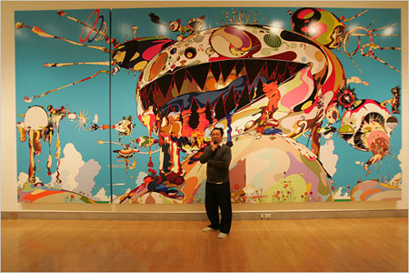
Redefining perception of icons
Takashi Murakami

Slide 3
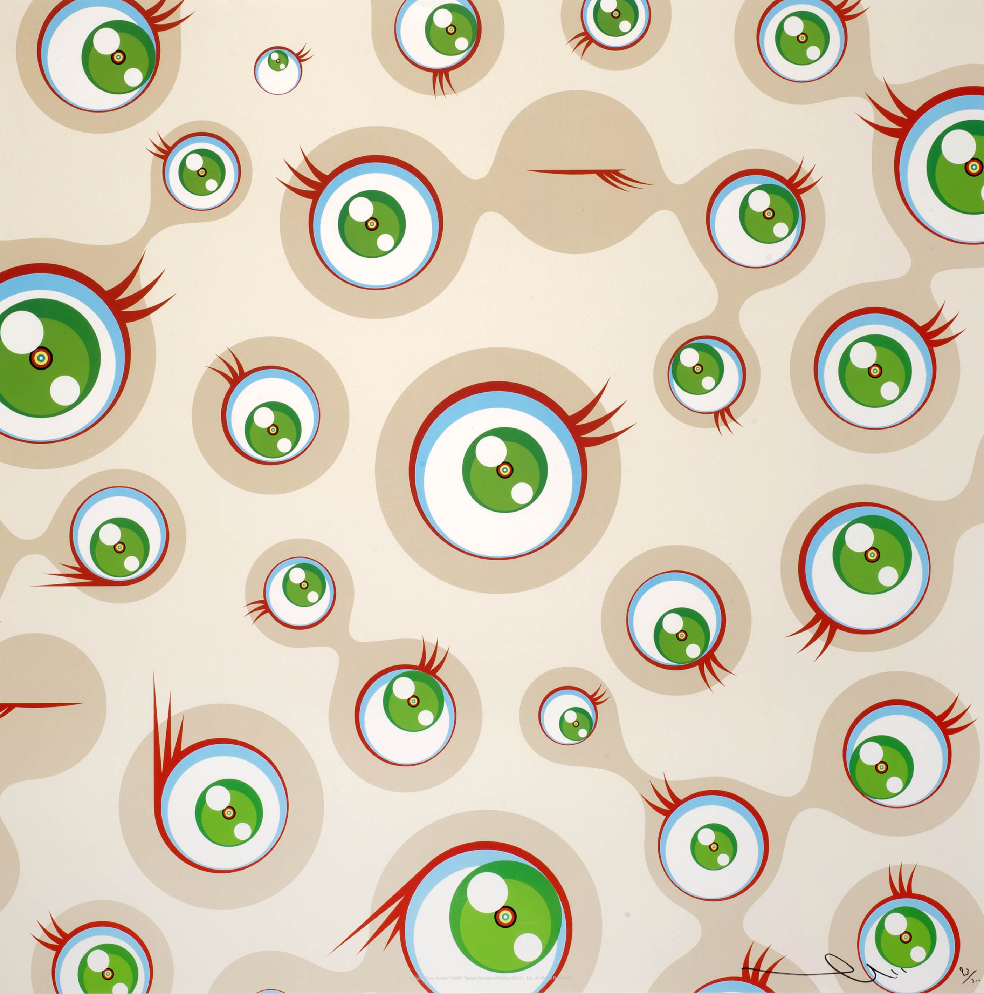
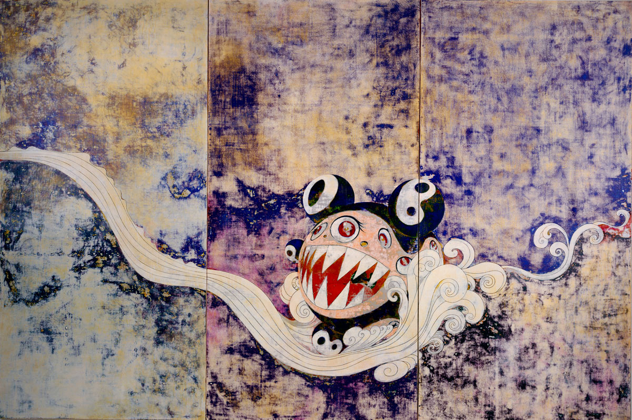
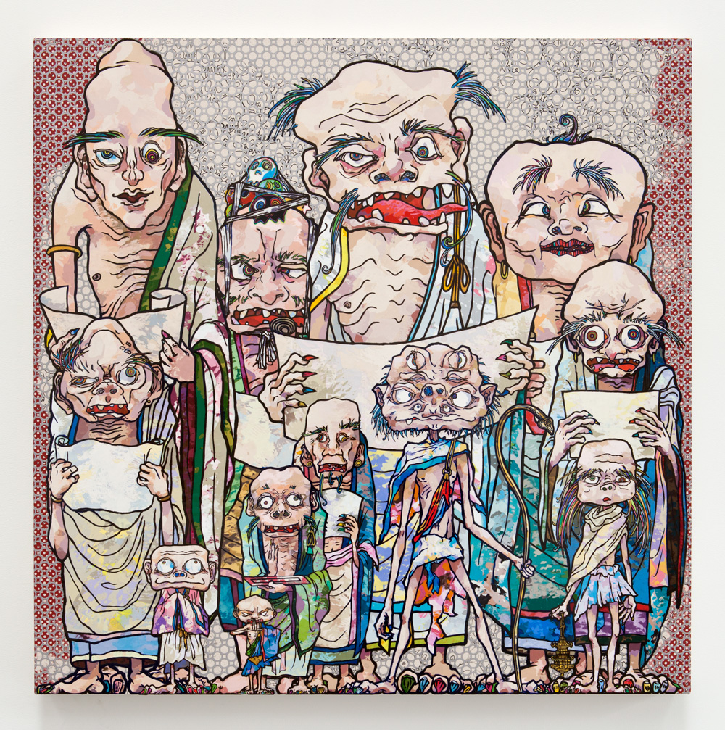
Redefining perception of icons
Takashi Murakami

Slide 4
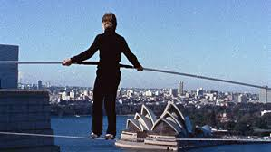
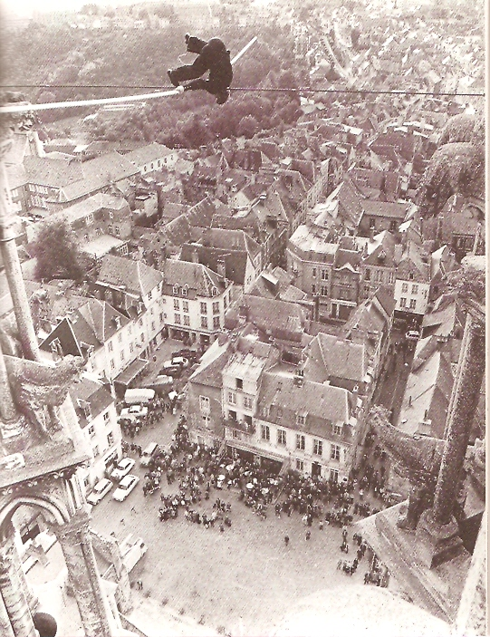
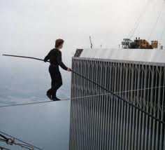
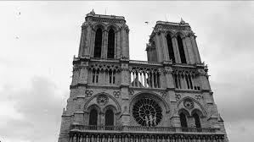
Persistence and Inspiration
Philippe Petit

Slide 5
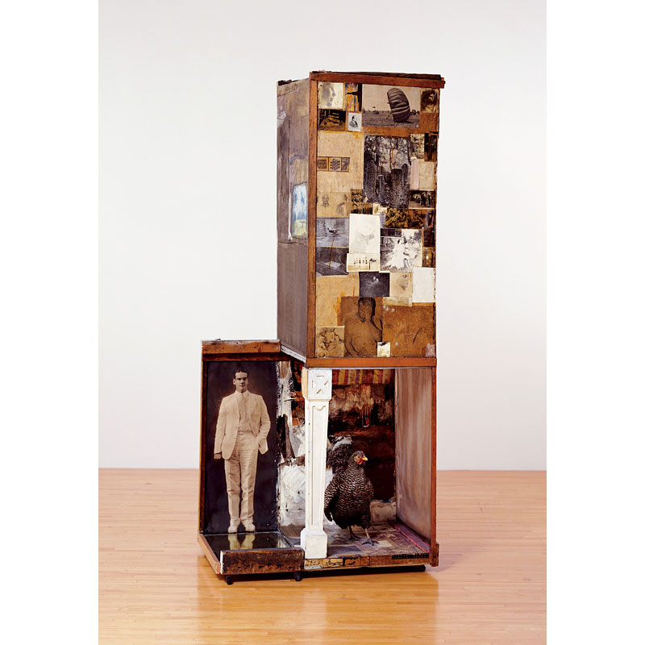
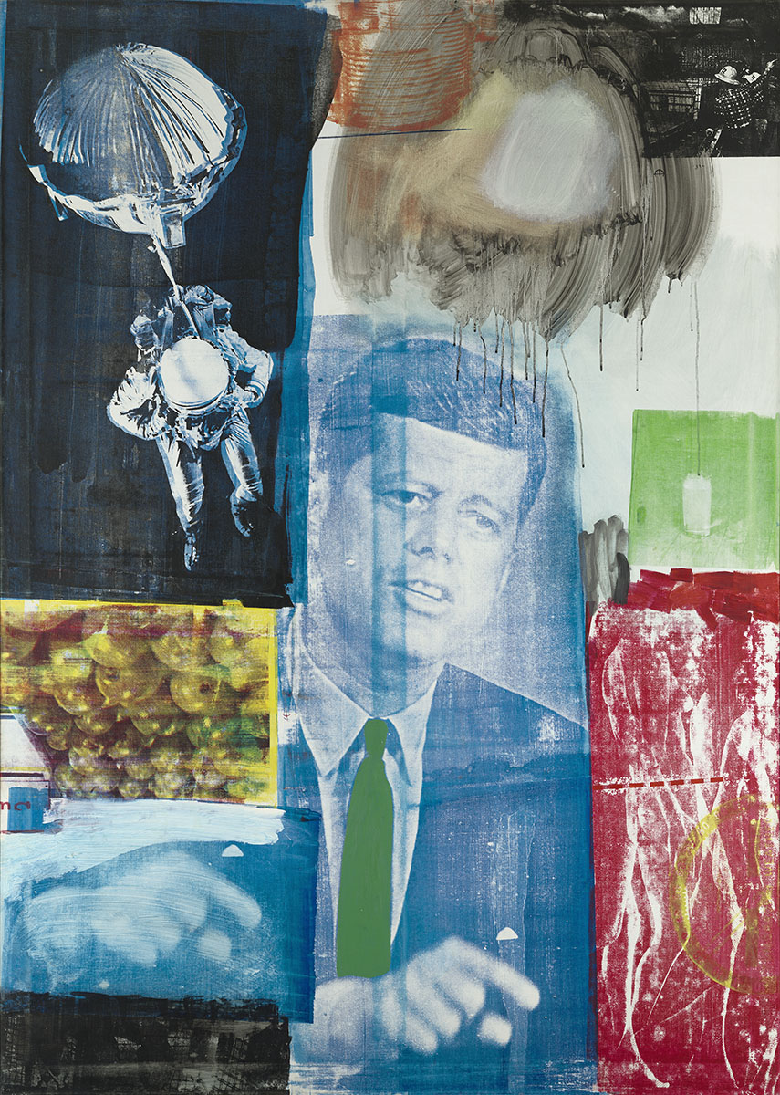
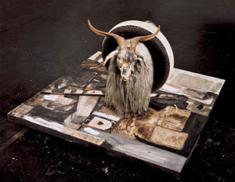
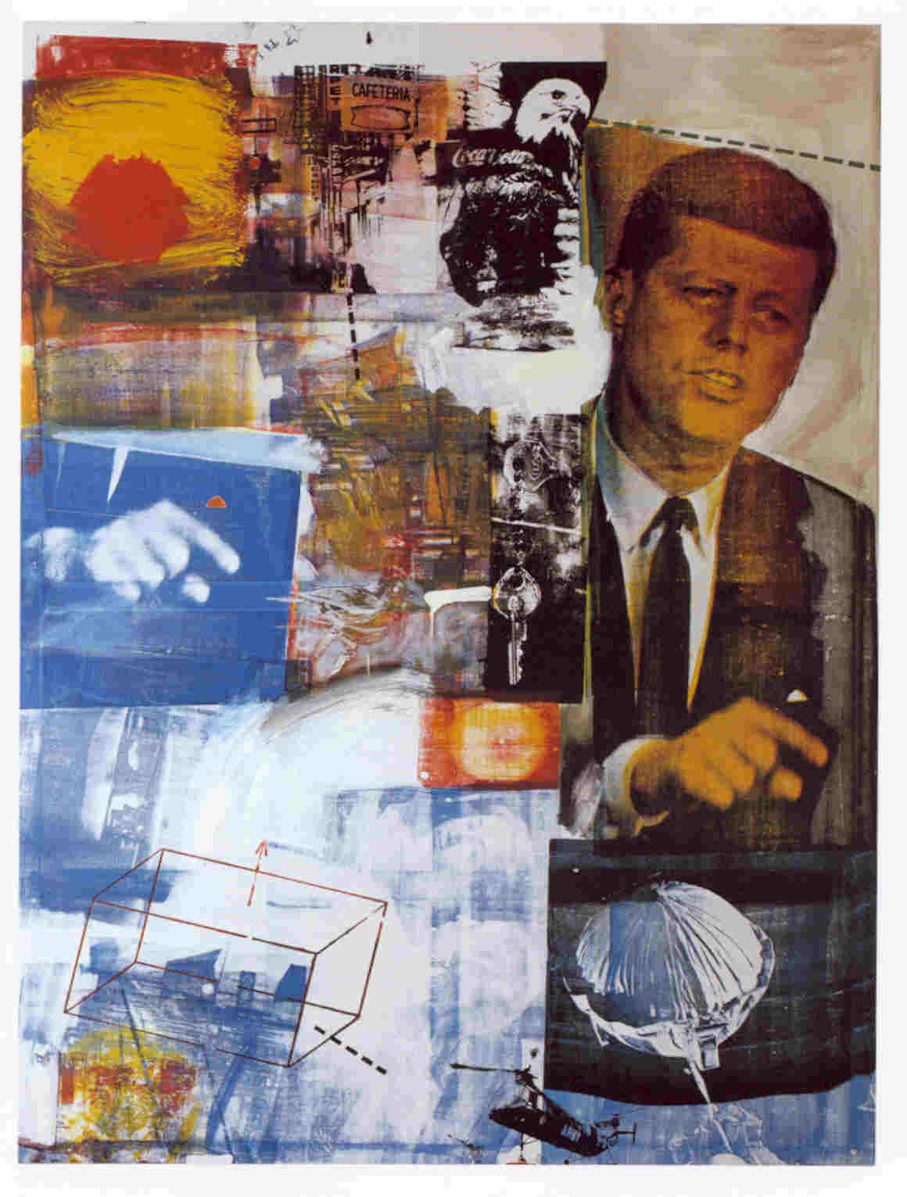
Finding Risk
Robert Rauchenberg

Slide 6
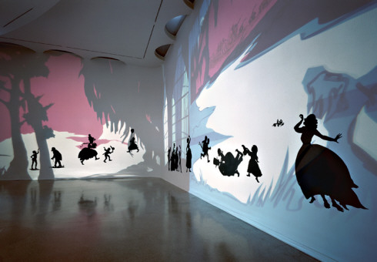
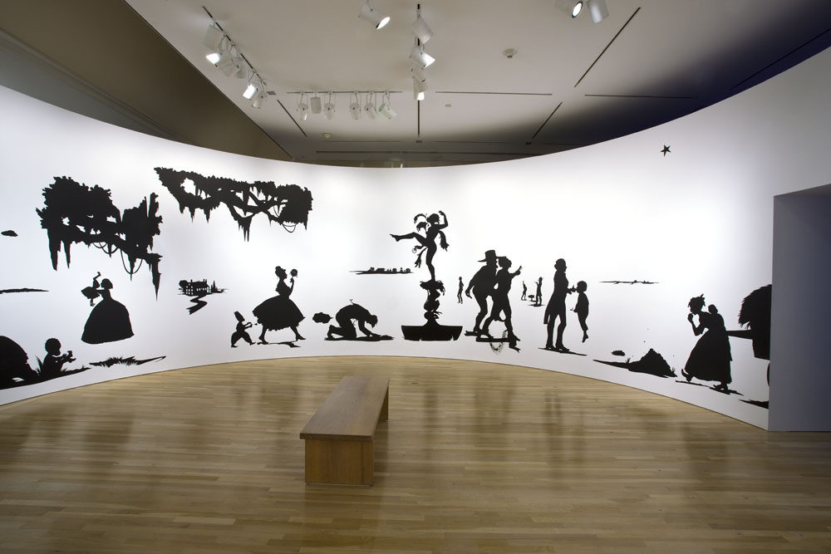
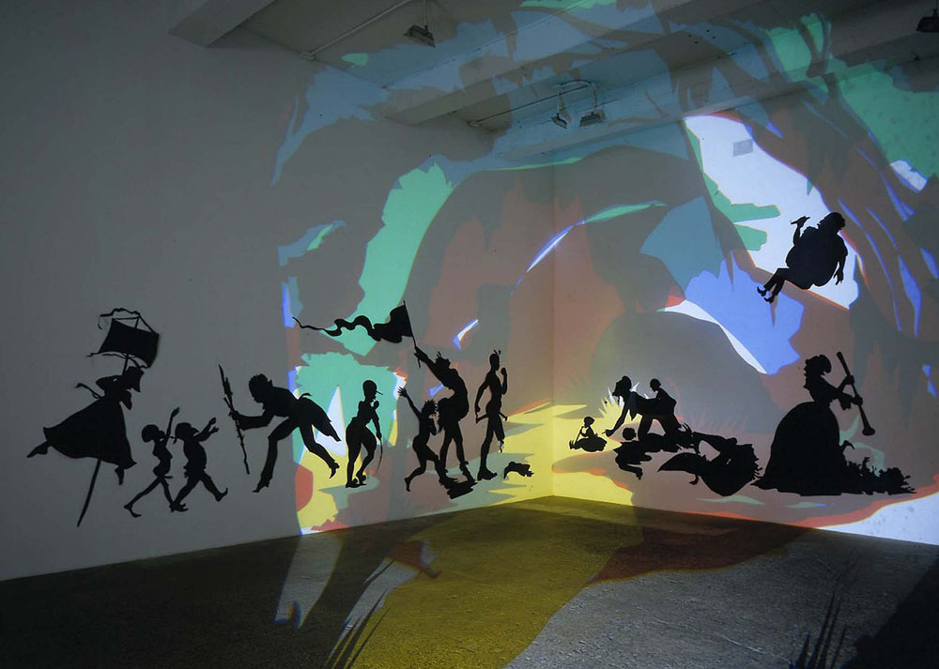
Risking Self
Kara Walker

Slide 7
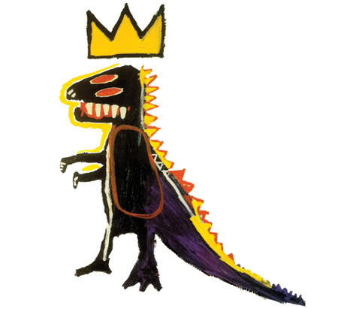
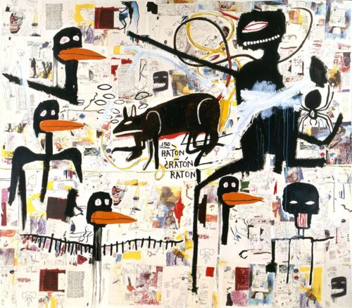
Risking Self
Basquiat

Slide 8
Unpopular Opinions
Dina Goldstein

Slide 9
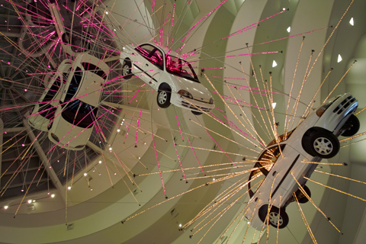
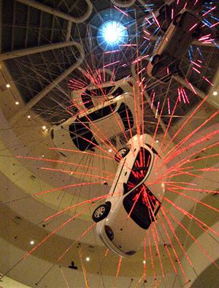
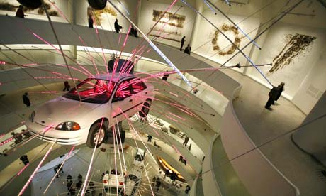
Installing Inception
Cai Guo-Qiang

Slide 10
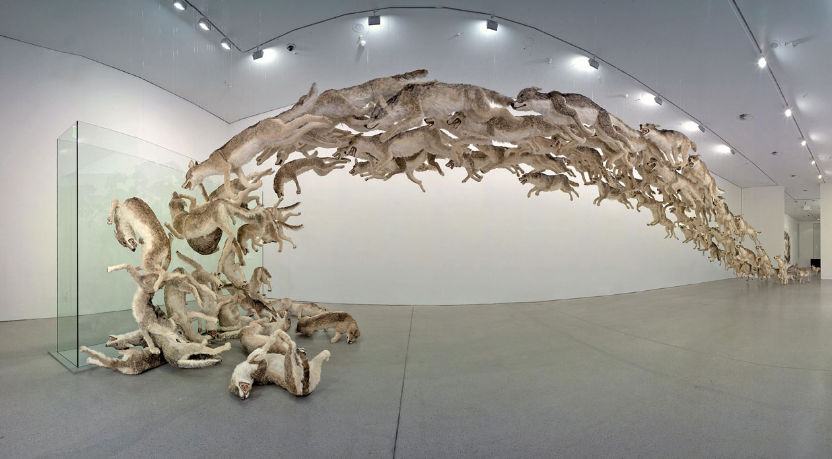
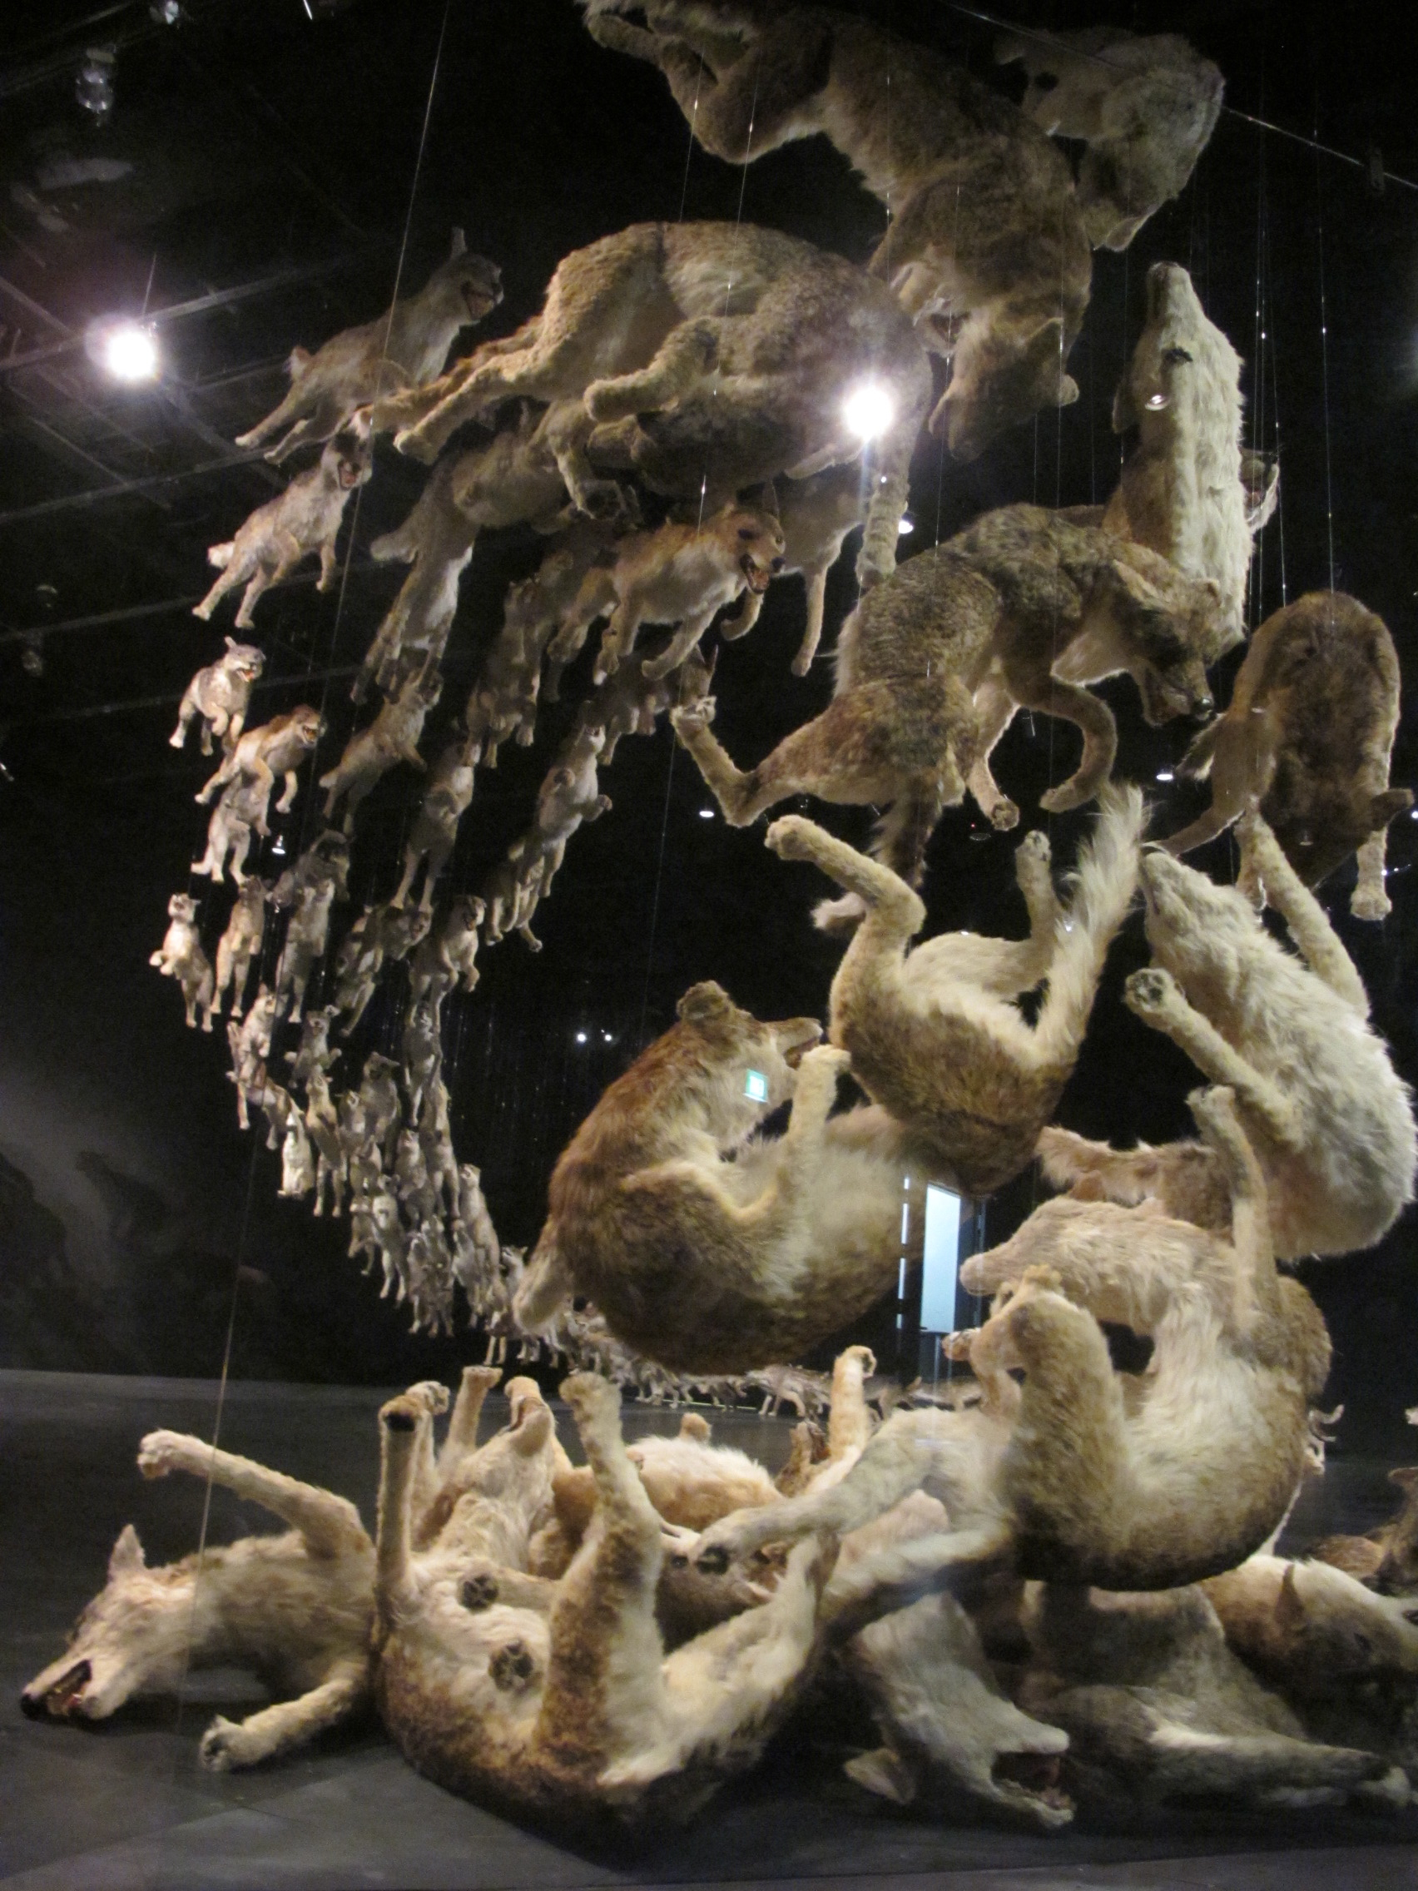
Installing Inception
Cai Guo-Qiang

Slide 11
SPACE
Redefining our surroundings
Beyond the architecture
Need to express sense of history/permanence
Barriers and practicality
Natural manipulation
Ideas permeating space in monuments
Significance of human story – immortality
Discuss

Slide 12
Risking it all….
What Risks Will YOU Take?

