Slide 1
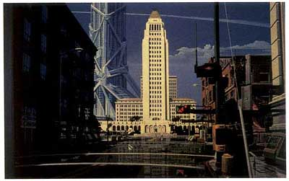
Getting Some Perspective
LA2015 Syd Mead

Slide 2
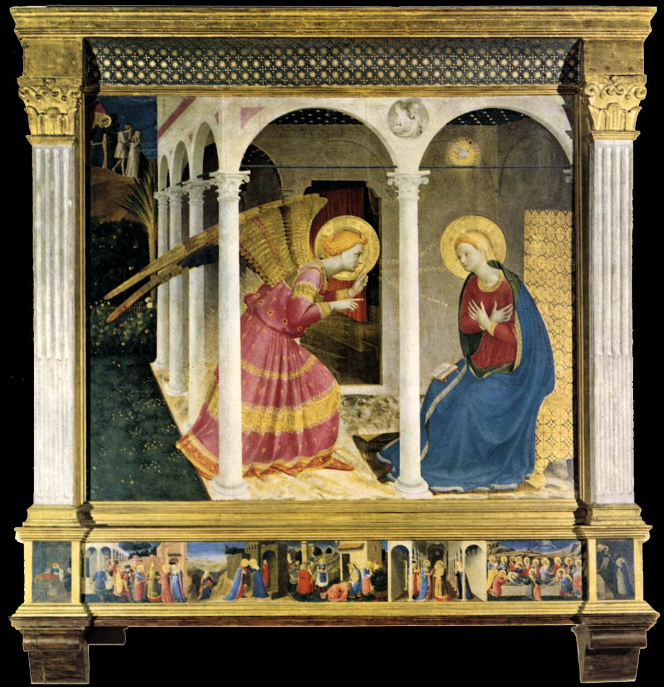
Fra Angelico
Annunciation

Slide 3
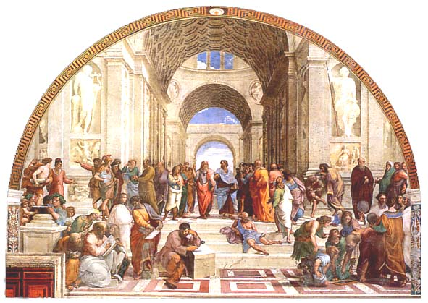
Raphael
School of Athens

Slide 4
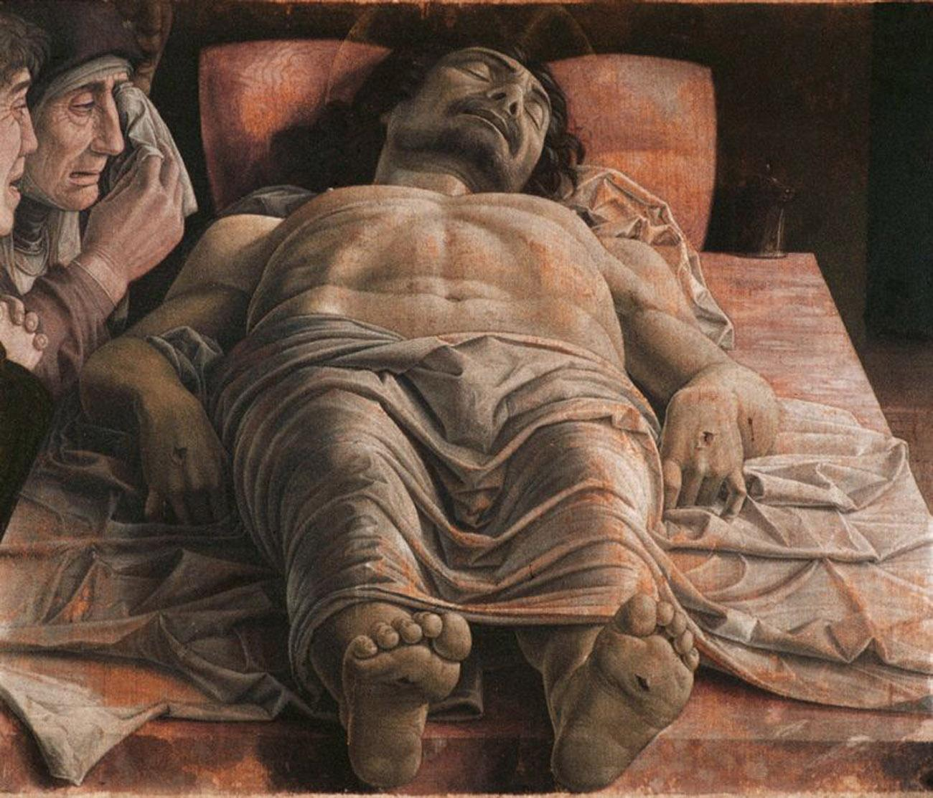
Andrea Matenga
Lamentation
of Christ

Slide 5
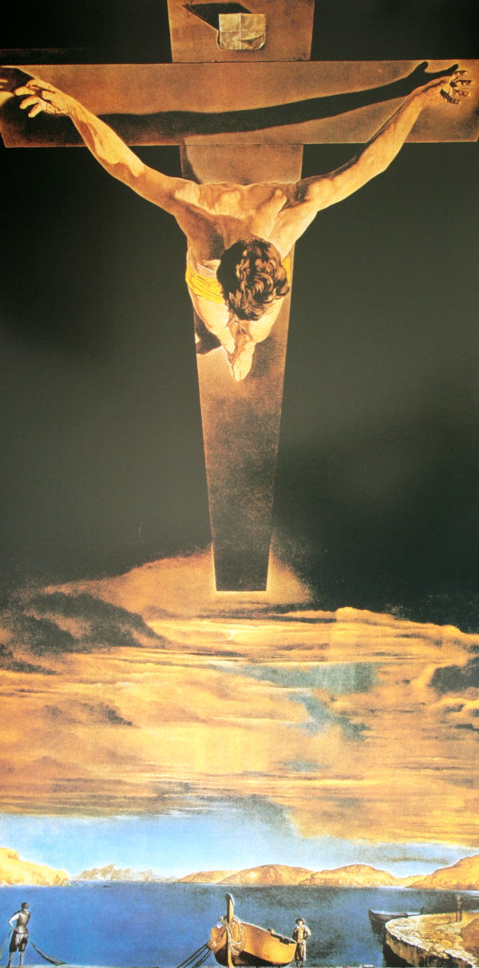
Salvador Dali
Christ of
St. John of the Cross

Slide 6
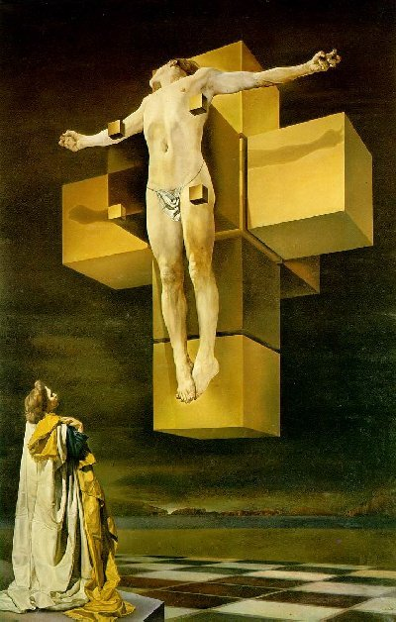
Salvador Dali
Corpus
Hypercubus

