Slide 1
SPACE
Redefining our surroundings

Slide 2
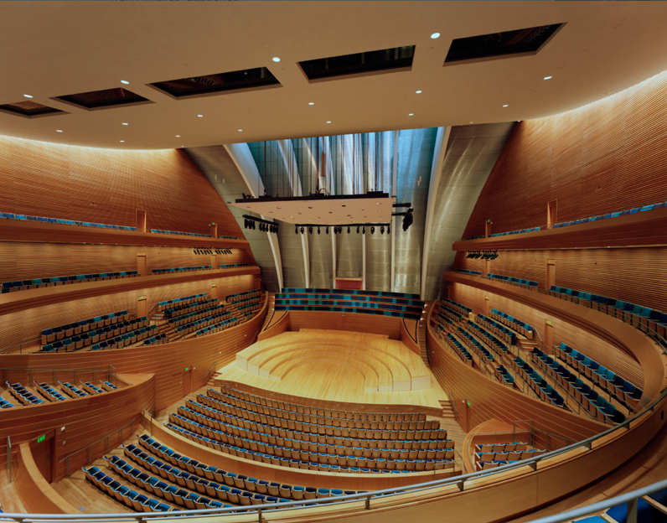
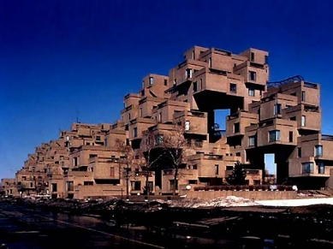
Questioning definitions of shelter
Moshe Safdie

Slide 3
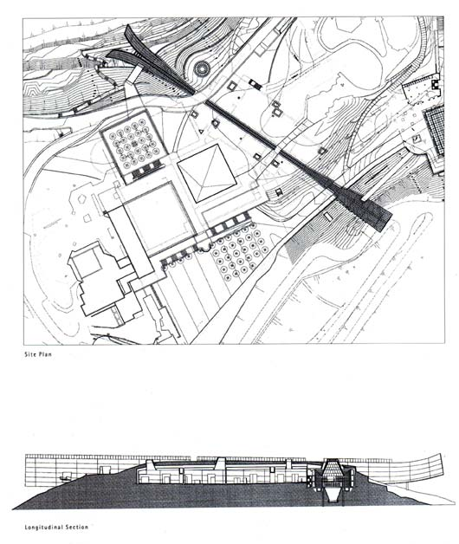
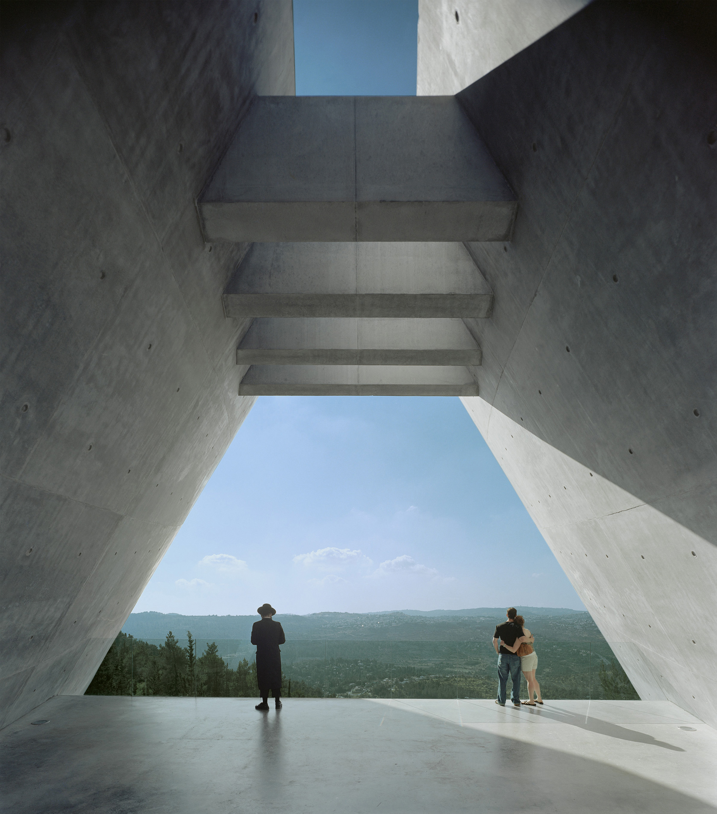
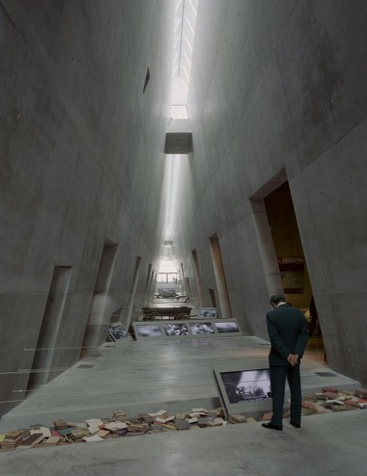
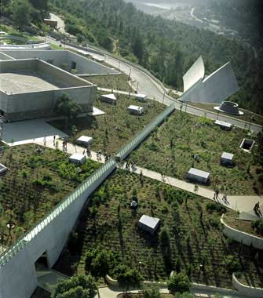
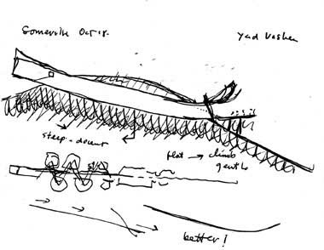
SPACE
Redefining our surroundings
Notes:
Need to express sense of history/permanence
Natural manipulation
Ideas permeating space in monuments
Significance of human story – immortality
Discuss

Slide 4
Notes:
Need to express sense of history/permanence
Natural manipulation
Ideas permeating space in monuments
Significance of human story – immortality
Discuss

Slide 5
Notes:
Need to express sense of history/permanence
Natural manipulation
Ideas permeating space in monuments
Significance of human story – immortality
Discuss

Slide 6
Notes:
Need to express sense of history/permanence
Natural manipulation
Ideas permeating space in monuments
Significance of human story – immortality
Discuss

Slide 7
Notes:
Need to express sense of history/permanence
Natural manipulation
Ideas permeating space in monuments
Significance of human story – immortality
Discuss

Slide 8
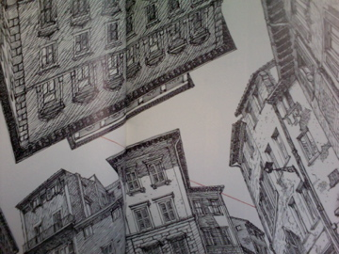
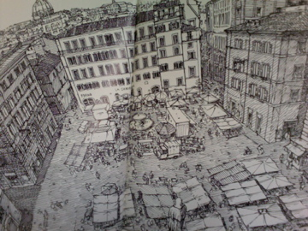
Defining our cultures
Rome Antics – David Macaulay

Slide 9
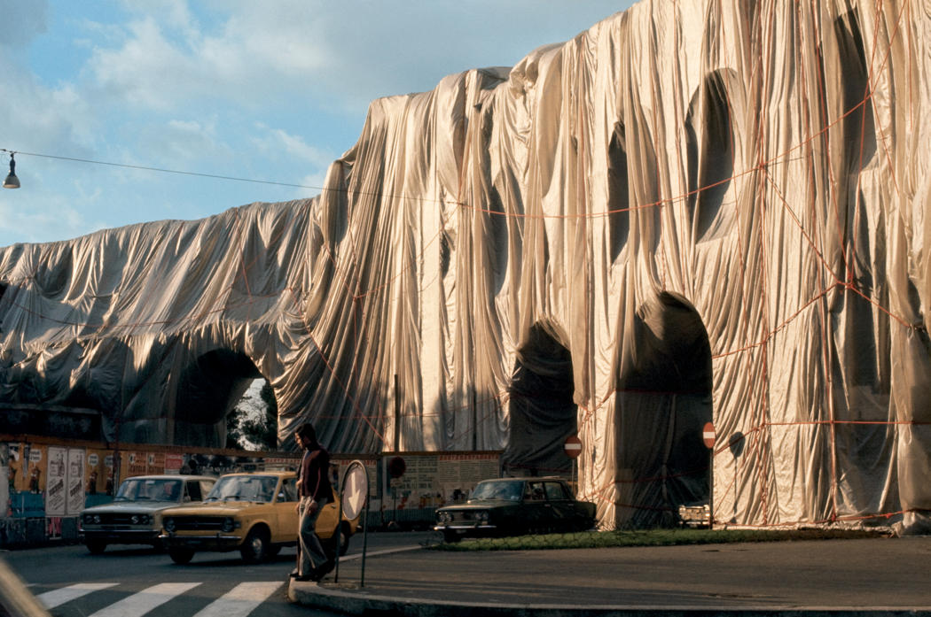
Questioning reality and definitions of art
Christo and Jean Claude

Slide 10
Notes:
Beyond the architecture
Need to express sense of history/permanence
Barriers and practicality
Significance of human story – immortality
Discuss

Slide 11
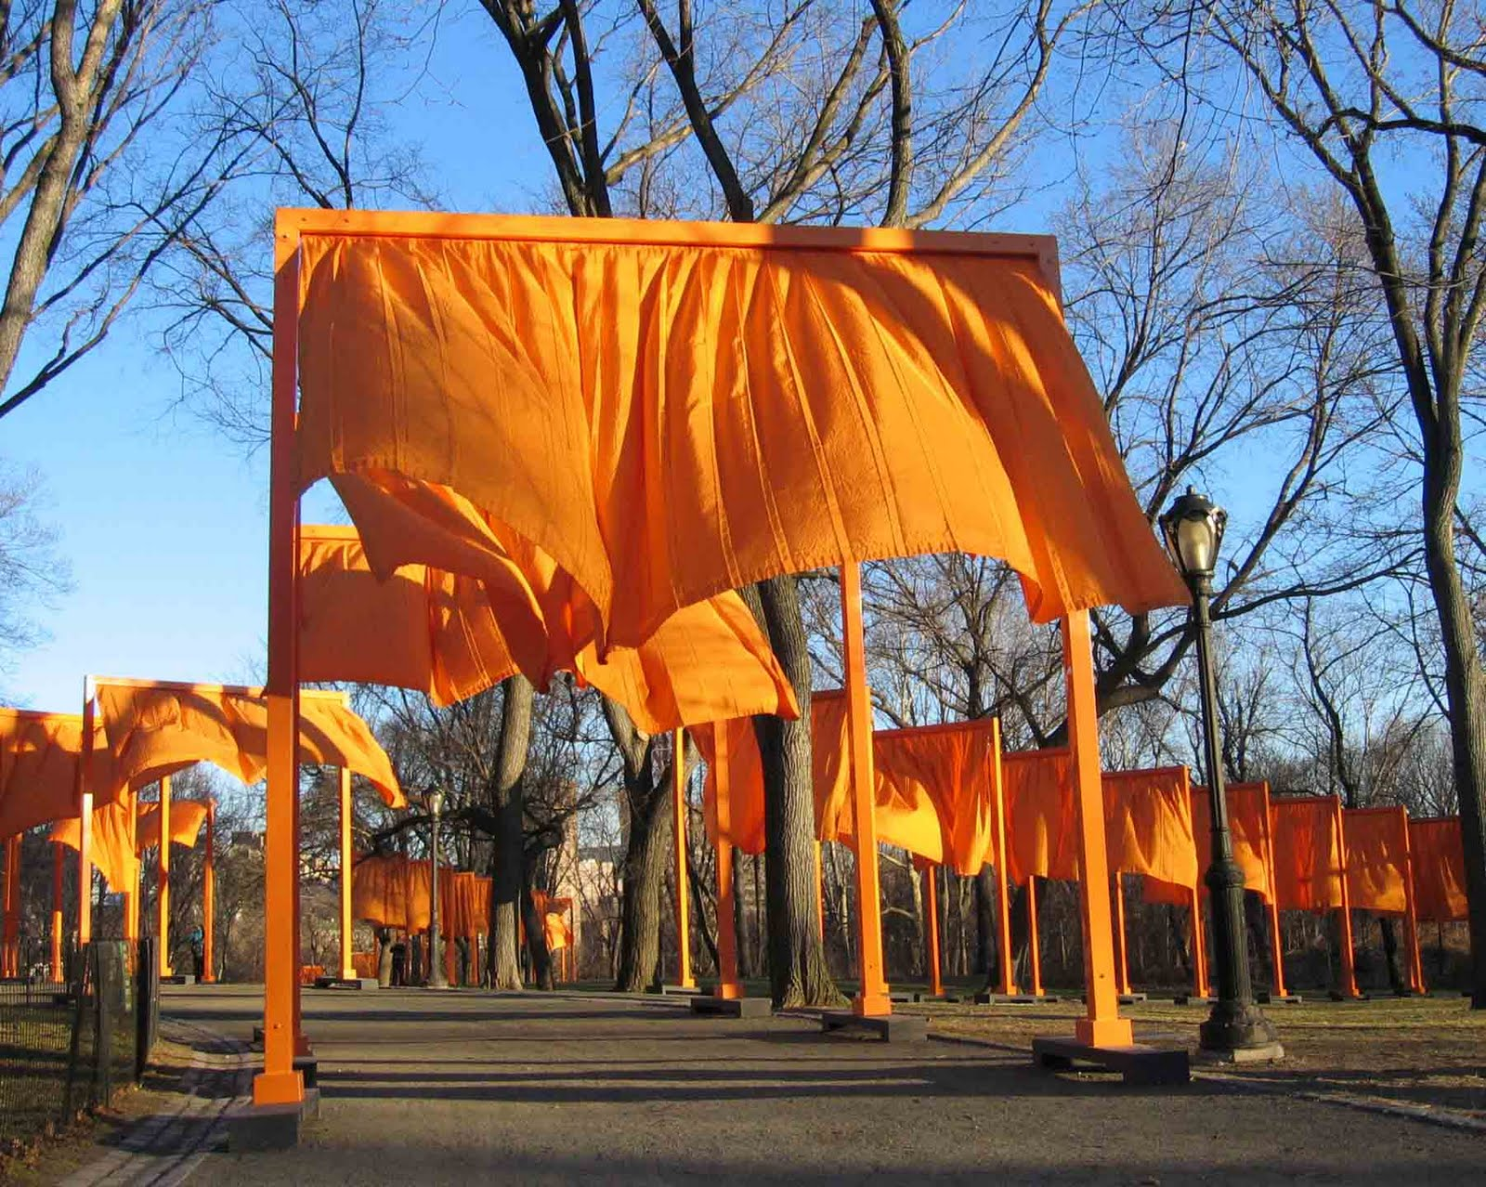
Creating new spaces within the familiar
The Gates – Central Park

Slide 12
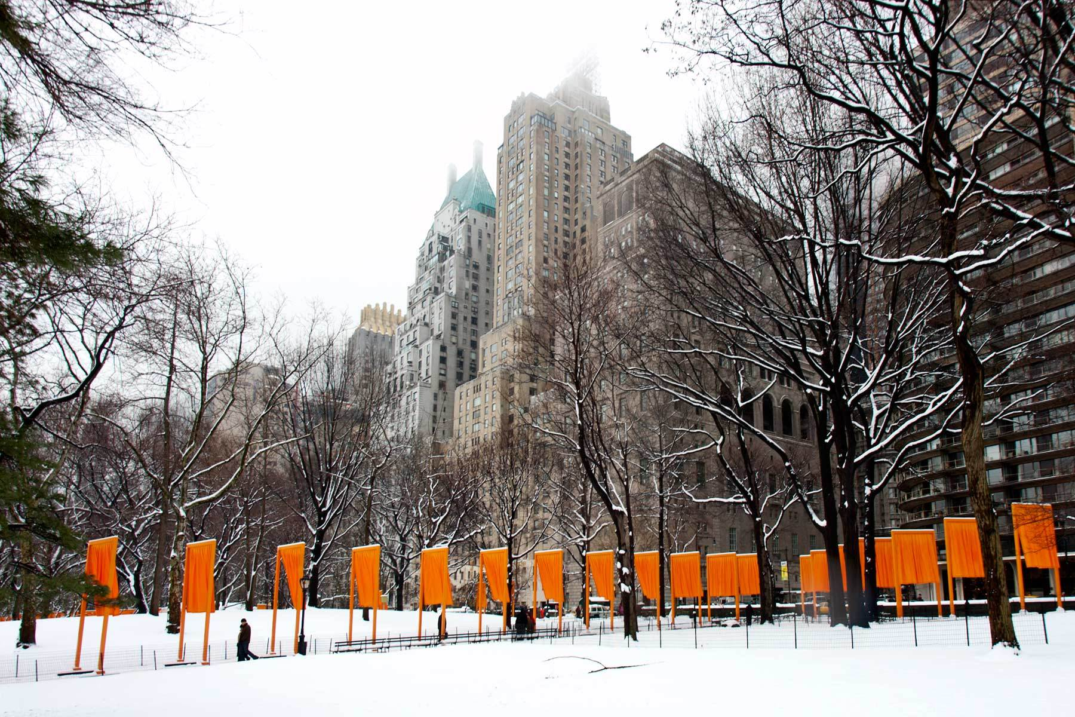

Slide 13
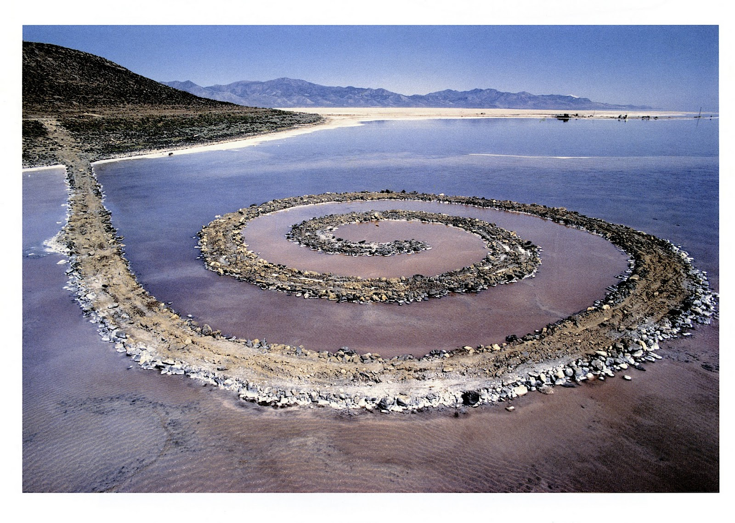
The Spiral Jetty by Robert Smithson
Notes:
Rozel Point, Great Salt Lake, Utah April 1970
Mud, precipitated salt crystals, rocks, water coil
1500’ long, 15’ wide
Barriers and practicality
Natural manipulation
Ideas permeating space in monuments

Slide 14
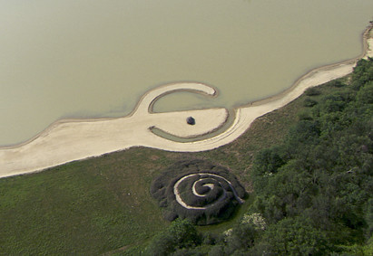
Notes:
Broken Circle/Spiral Hill

Slide 15
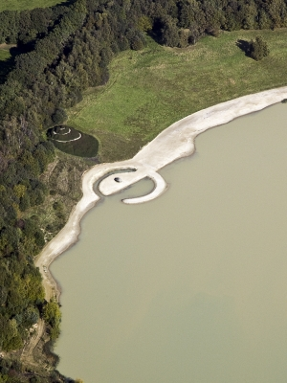
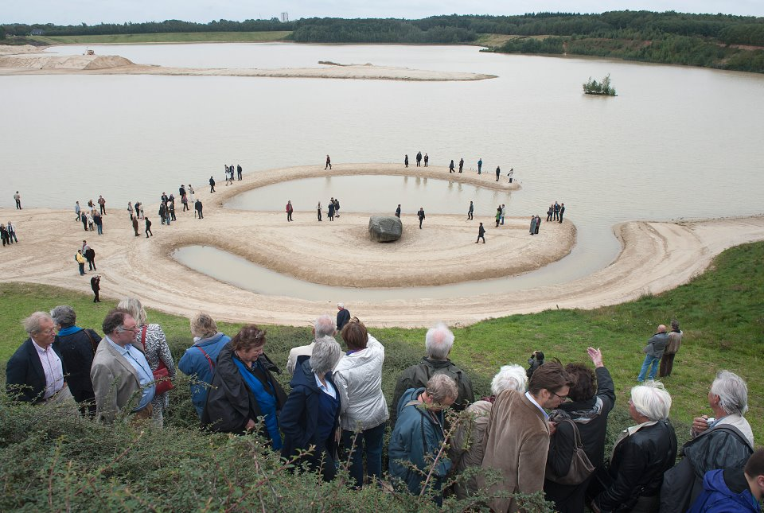
Broken Circle/Spiral Hill Robert Smithson
Notes:
Broken Circle/Spiral Hill
Emmen, The Netherlands

Slide 16
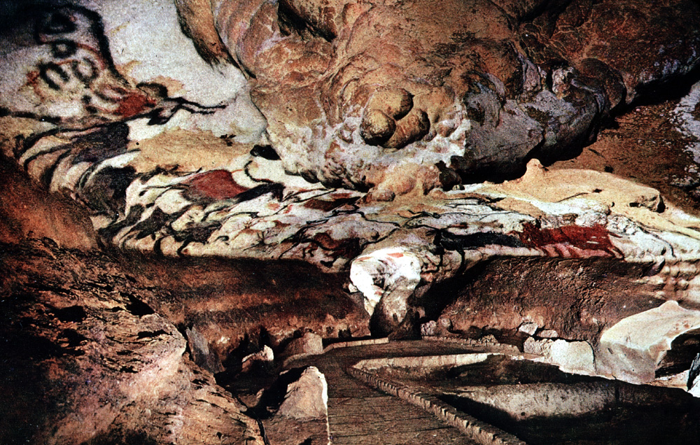
Redirecting our cultures
Caves at Lascaux and Chauvet

Slide 17
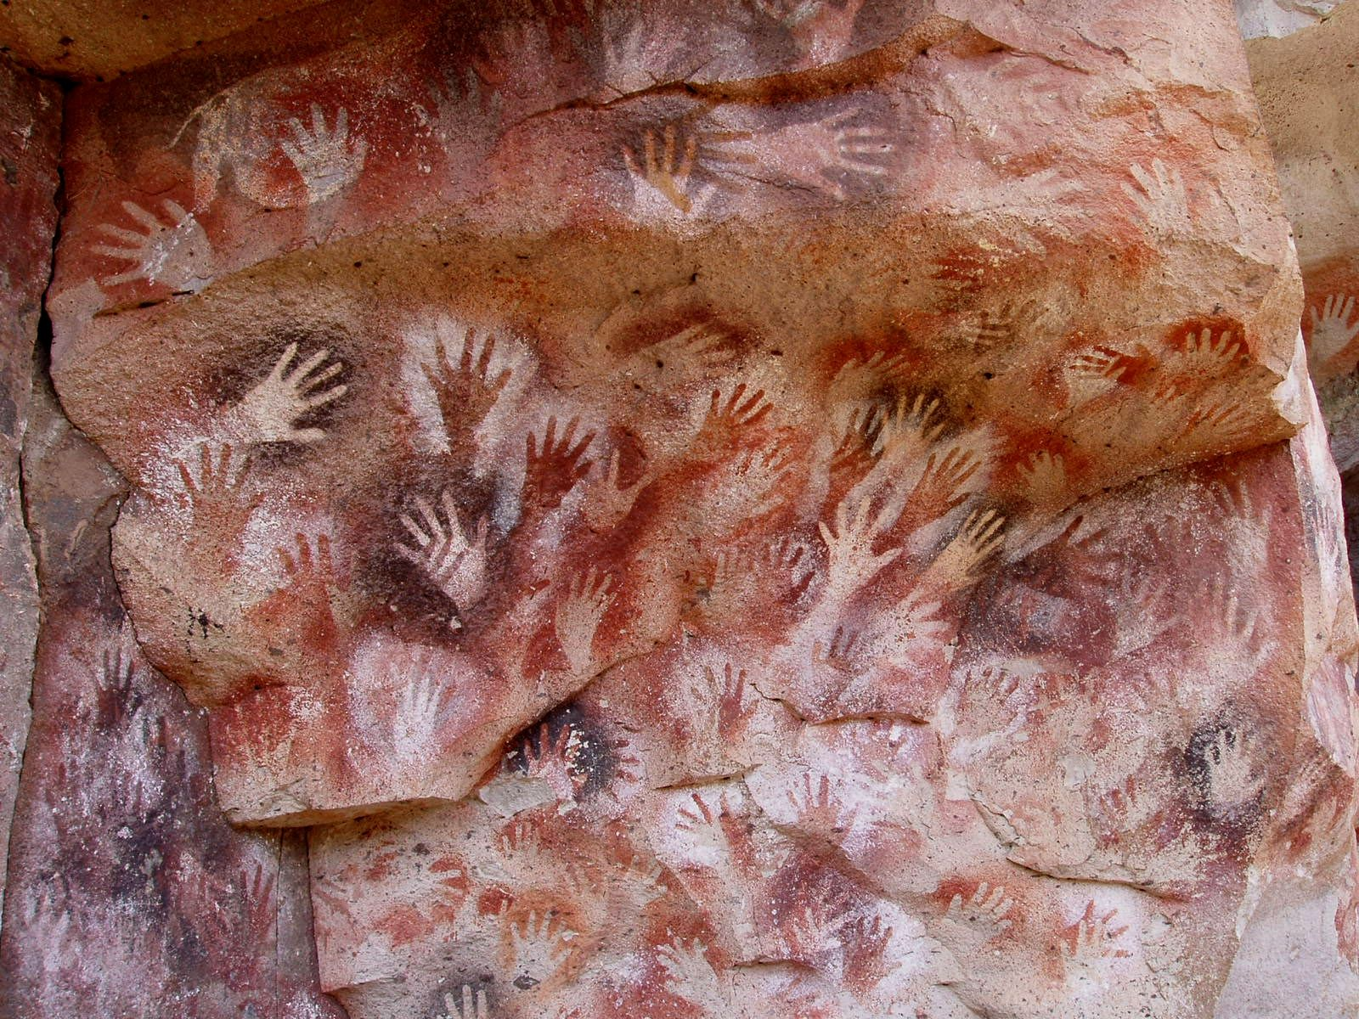
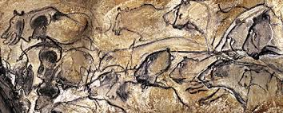
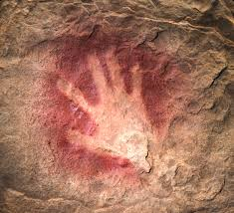
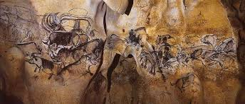
Redirecting our cultures
Caves at Lascaux and Chauvet

Slide 18
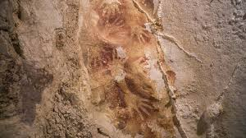
Maros-Pangkep Caves Indonesia

Slide 19
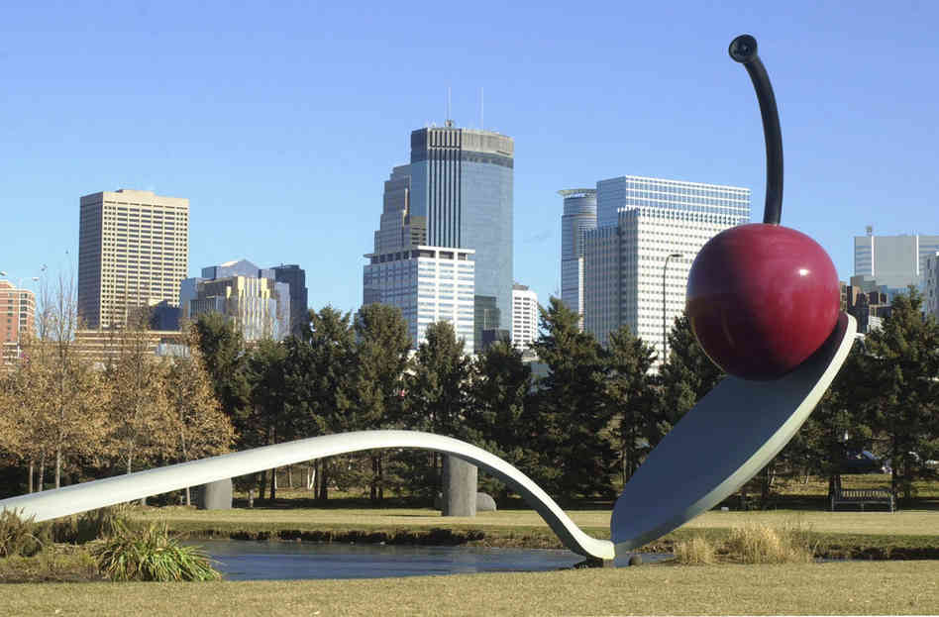
Creating Monuments
Claes Oldenburg & Cossje van Bruggen

Slide 20
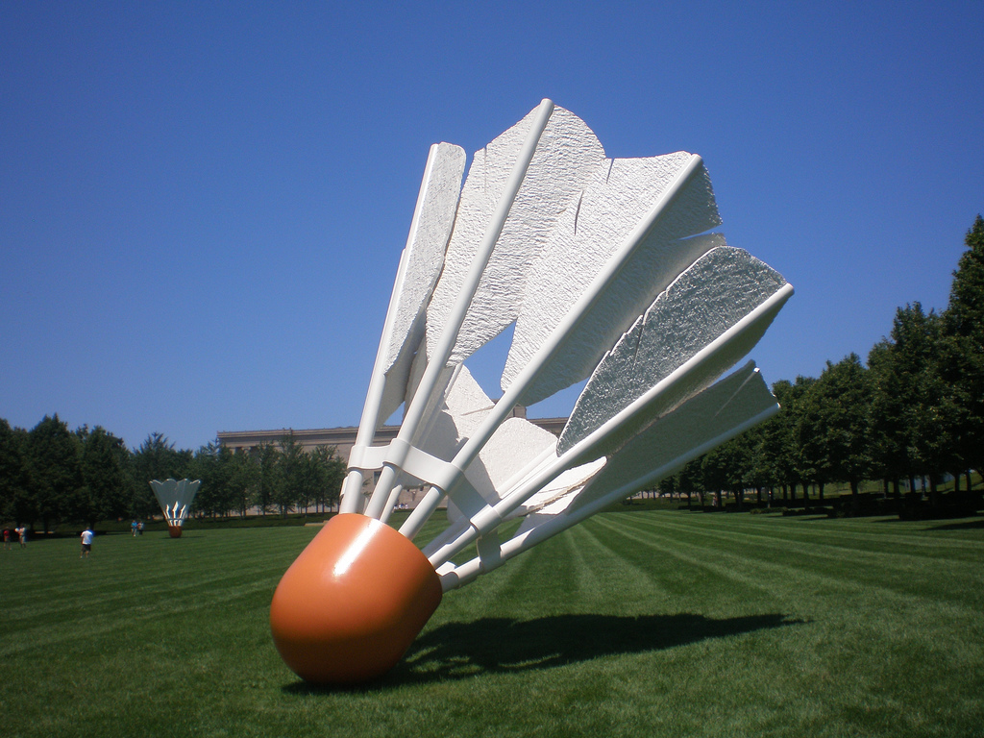

Slide 21
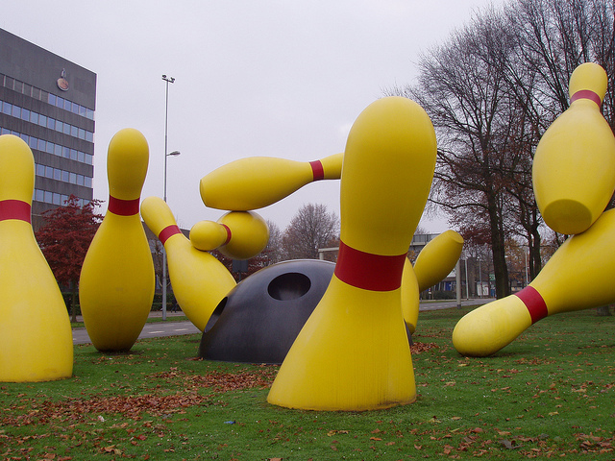
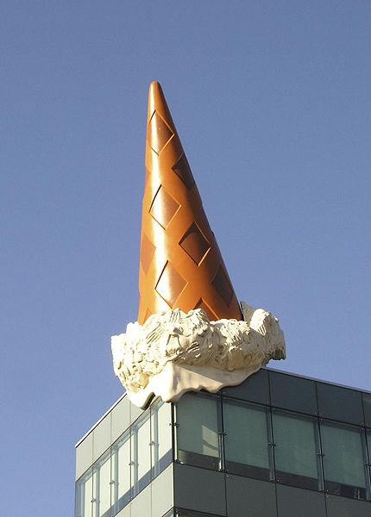

Slide 22
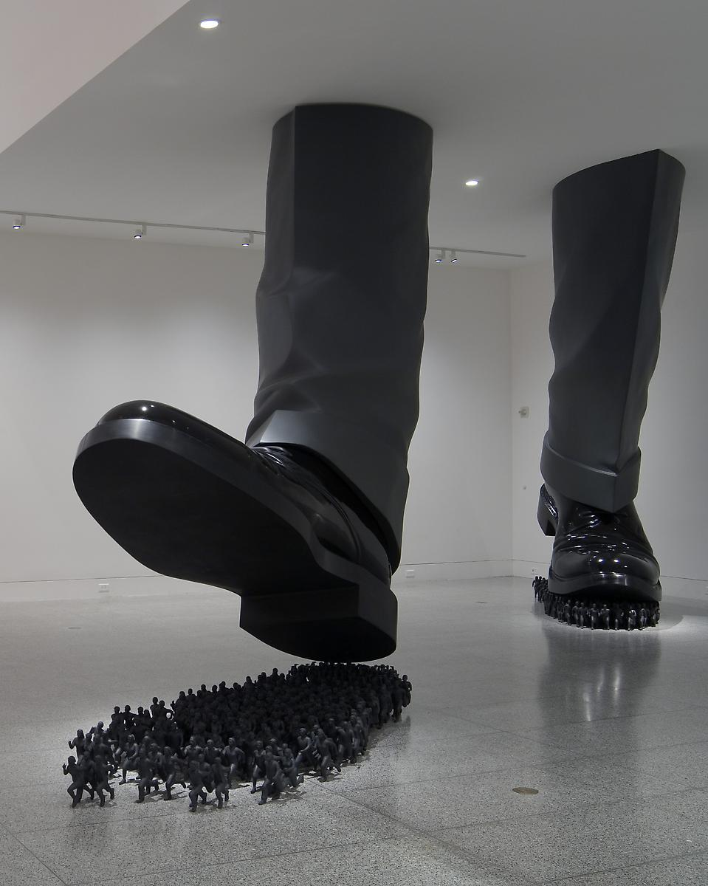
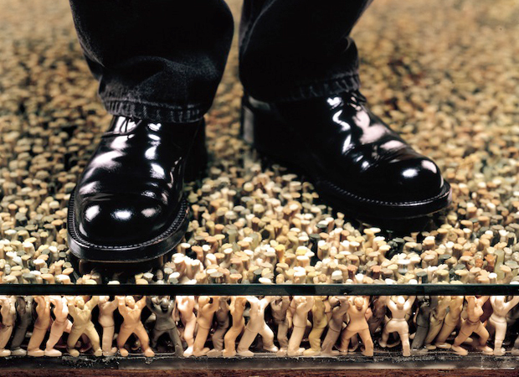
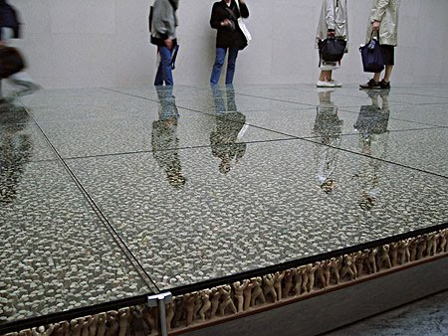
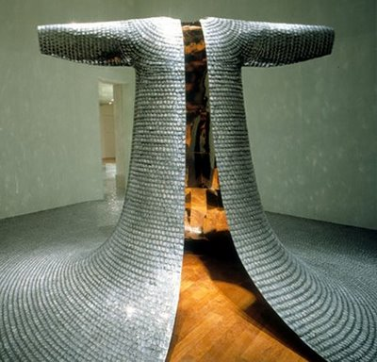
SPACE
Do Ho Suh

Slide 23
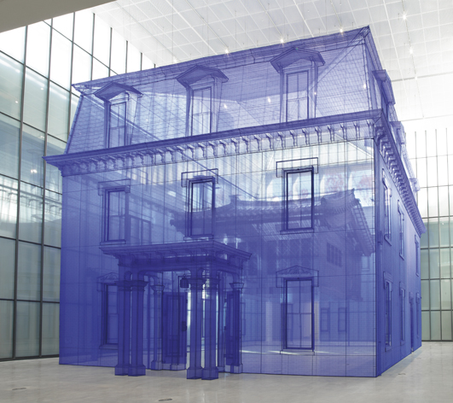
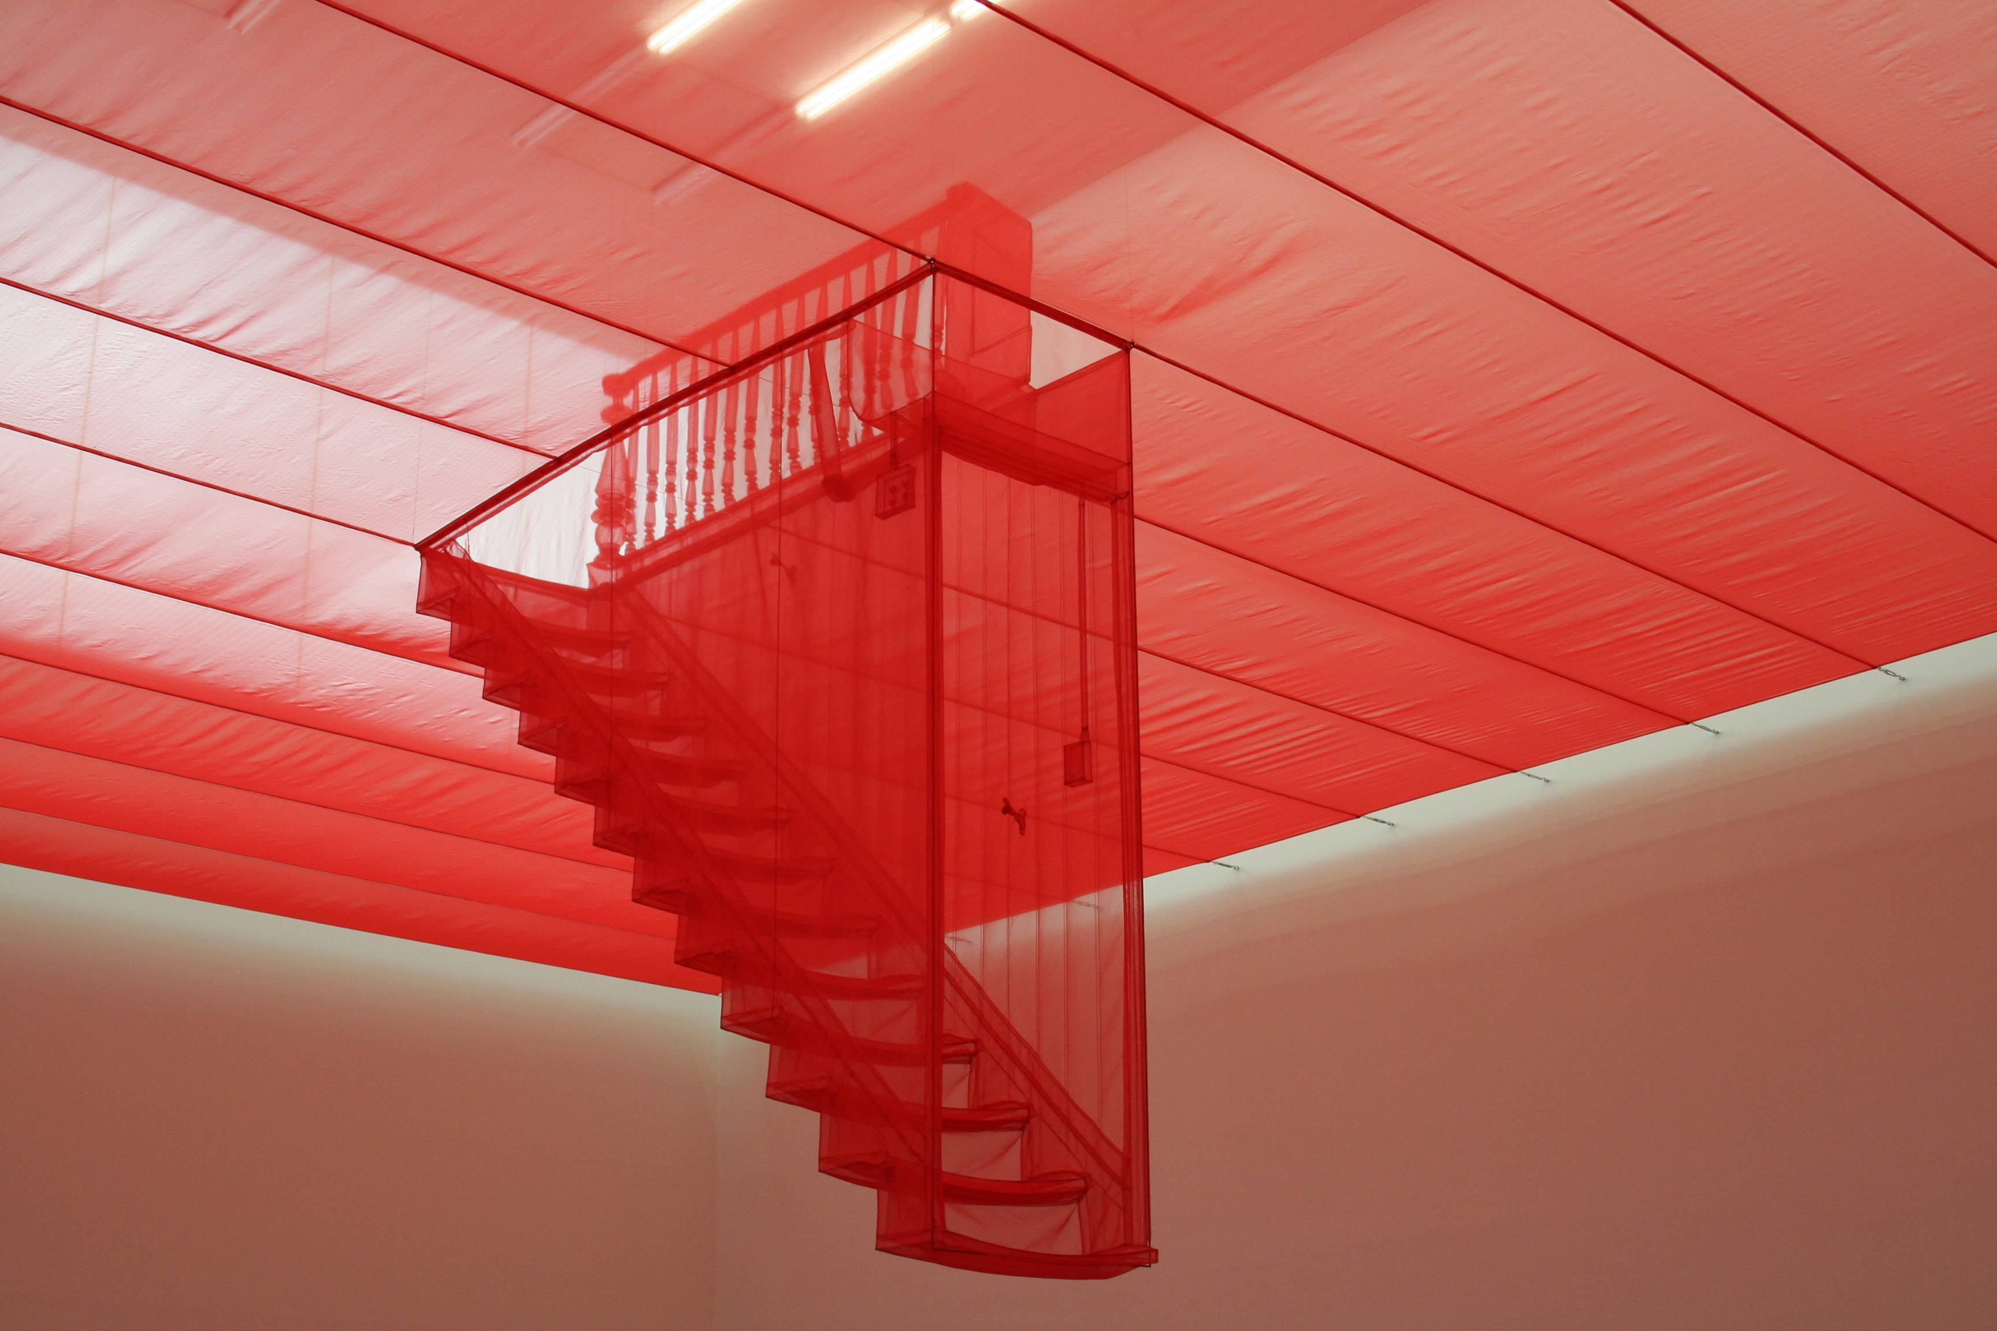
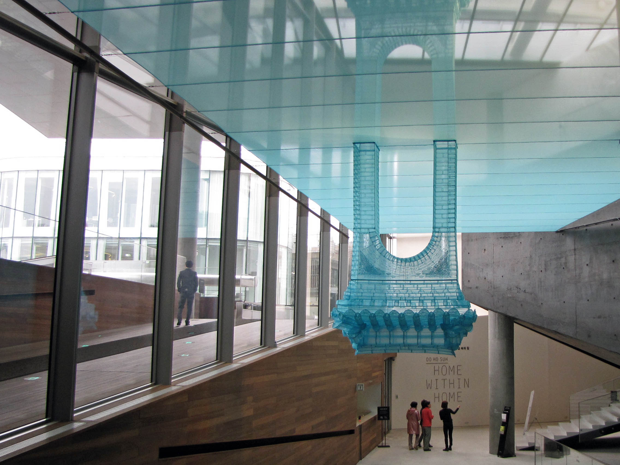
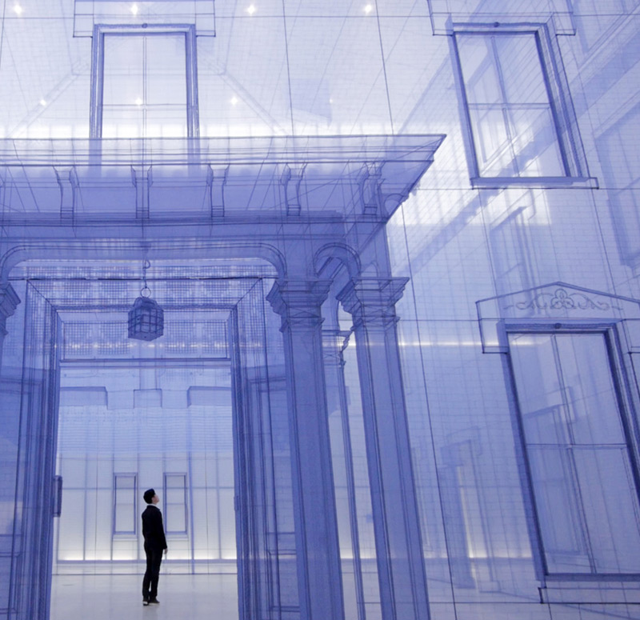

Slide 24
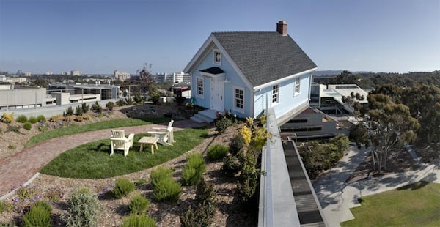

Slide 25
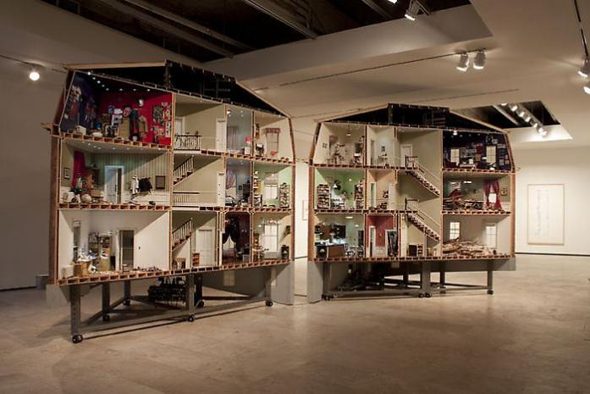

Slide 26
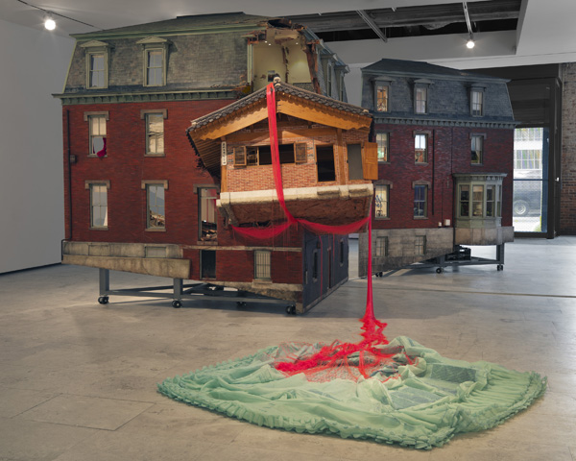

Slide 27
SPACE
Redefining our surroundings
Beyond the architecture
Barriers and practicality
Ideas permeating space in monuments
Significance of human story – immortality
Discuss

Slide 28
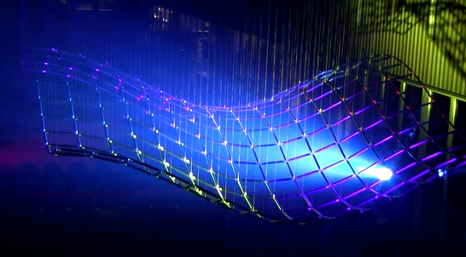
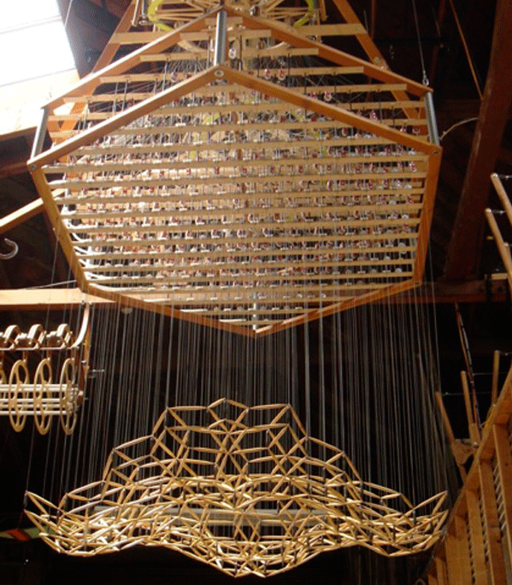
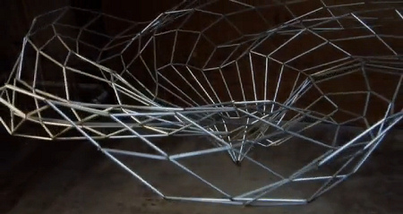
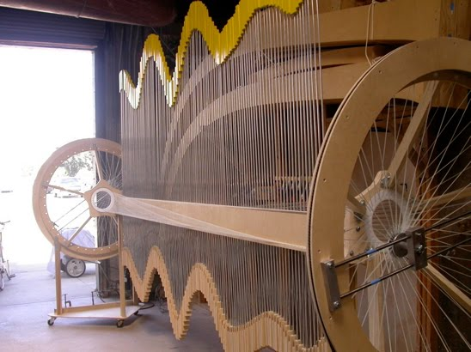
Manipulating spatial relations
Reuben Margolin

